Slide 1
Learning Difficulties: the hidden learning problems

Slide 2

Common Misconceptions about LDs
"If she would just
pay attention,
she would get it."
"He has the ability.
If he just tried harder, he
could do it. He chooses not
to do the work."
"After I give the instructions, he sits there and stares at his paper. He is not motivated."

Slide 3

We know this person has a problem.
We can see the disability.

Slide 4


These difficulties are not visible,
but they are
very real.

Slide 5
Literacy – the ability to access and apply information from the printed word - enables access to social and economic systems, and plays a key role in overall development.

Slide 6
Lower adult literacy reduces economic growth and affects employment, wages, health, and education.

Slide 7
Many citizens lack the literacy skills required to contribute fully to Canada’s economy and public life.

Slide 8
Learning disabilities
Literacy problems

Slide 9


What do learning disabilities look like?

Slide 10
LD Children may
- show frustration.
- avoid reading.
- not 'get' math.
- act up in class or be
extremely shy.

Slide 11
All have poor or uneven academic achievement in spite of normal or above
-normal intelligence.

Slide 12
Types of Learning Disabilities
Reading problems (Dyslexia)
Difficulty processing language
Problems reading, writing, spelling, speaking

Slide 13
Math problems (Dyscalculia)
Difficulty with math concepts, math problems, understanding time, using money

Slide 14
Writing problems (Dysgraphia)
Difficulty with forming letters and numbers
Problems with handwriting, spelling, organizing ideas

Slide 15
Coordination problems
(Dyspraxia – Sensory Integration Disorder)
Difficulty with fine motor skills
Problems with hand–eye coordination, balance, manual dexterity

Slide 16

Other
disorders
can make
learning
difficult.

Slide 17
ADD (ADHD) –
Children with
ADHD often have
problems with sitting still, staying focused, following instructions, staying organized, and completing homework.

Slide 18

  Autism –
  Children with an
  autism spectrum disorder may have trouble making friends, reading body language, communicating, and making eye contact.

Slide 19
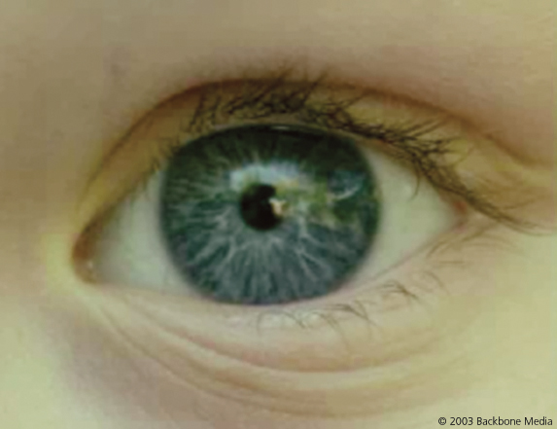
Visual Processing Disorder
A visual processing disorder
is a hindered ability to make sense
of information taken in through
the eyes.
Difficulties with visual processing
affect how visual information
is interpreted, or processed by
the brain.

Slide 20
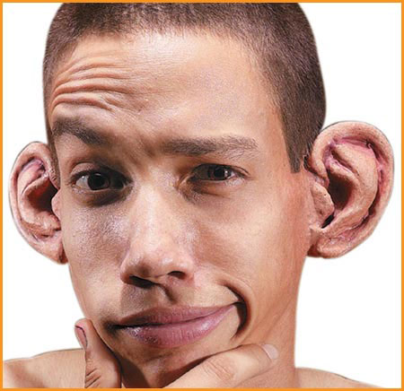
Auditory Processing Disorder
Interferes with the ability to
make sense of information taken in through the ears.
Difficulties do not affect what is heard by the ear, but how this information is interpreted by the brain.

Slide 21
FASD (Fetal Alcohol Syndrome Disorder)
Students with FAS may have difficulty
being over-stimulated by noise.
staying seated, so tend to fidget, squirm, or get out of the chair.
thinking before acting, so they are impulsive.
concentrating on a task.
expressing emotions and needs.

Slide 22
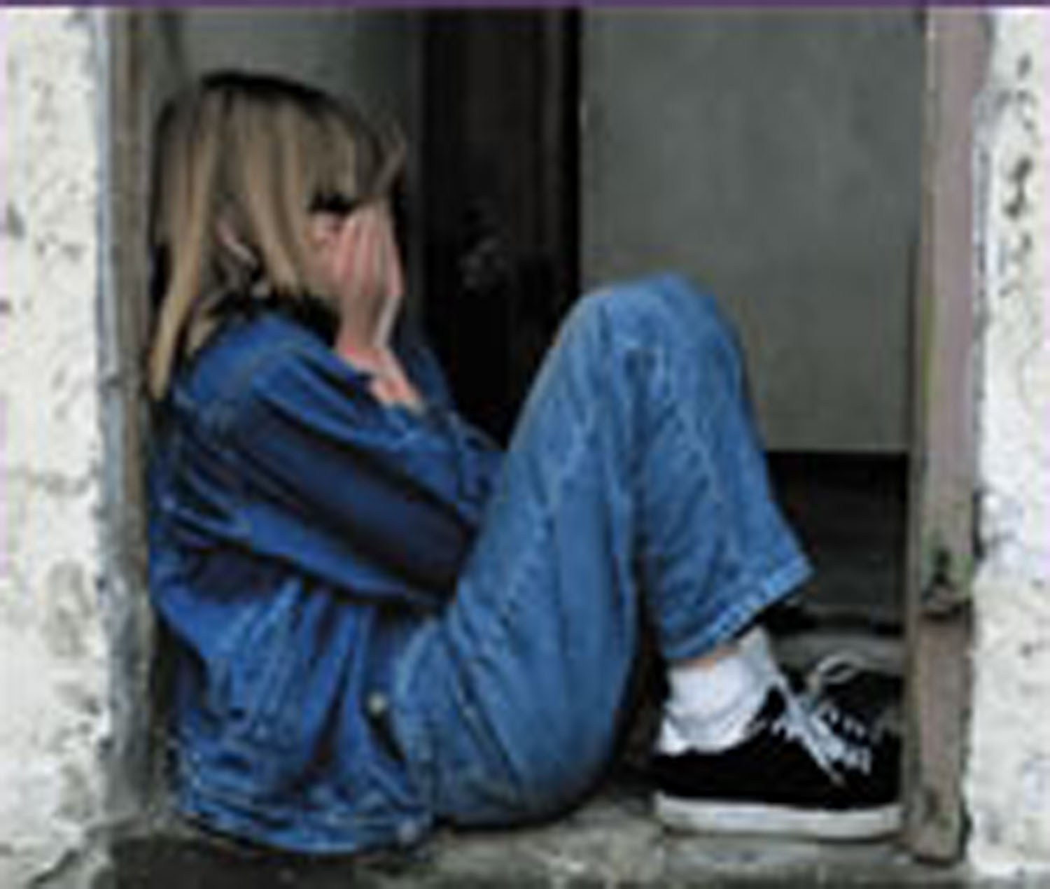
Severe Consequences of LDs
Those doing poorly in
school do not feel good
about themselves.
They may
withdraw from their
friends and social activities.

Slide 23
Consequences, continued
They may spend time with
others who view themselves as
losers, and this may contribute to
juvenile delinquency.
They may lose motivation and
drop out of school.

Slide 24
More consequences
Adults with learning disabilities typically hold a job for only three months.
45.6% of adult inmates with learning disabilities have previous youth court involvement.

Slide 25
50% of females with learning disabilities will be mothers within 3 to 5 years of leaving high school.
Almost 50% of adolescent suicides had previously been diagnosed as having learning disabilities.

Slide 26
30 to 50% of young offenders have Learning Disabilities, compared to 3 to 4% of the general population.
Young offenders with LD are over-represented in repeat offense rates and tend to commit more serious crimes on re-arrest.

Slide 27
Cost to Society:
The cost of detaining a young offender is approximately $100,000 a year.

Slide 28
Solutions Must Begin Early
75% of children with reading disabilities in grade 3, without early intervention, continue to have difficulties learning to read throughout high school and their adult life.

Slide 29
The most common long-term condition suffered by children 0 to 14 years of age is learning disabilities – HALS* reported that 95,580 children aged 0 to 14 years have this condition
*Statistics Canada's Health and Activity Limitation Survey (HALS) 1991

Slide 30
Persons scoring lowest on the literacy scales were much less likely to get any post secondary education, and were twice as likely to be unemployed as adults.
Learning Literacy in Canada: Evidence from the International Survey of Reading Skills 2008

Slide 31
Learning Difficulties
Some early learning difficulties turn into learning disabilities.
A student who struggles to learn to read through the whole language model can become permanently reading disabled.

Slide 32
The inability to understand math concepts the way they are taught in the early years can lead to a lifelong disability in the area of math.
“New math” aims to teach kids to do math in their heads instead of with a pencil. This impedes those whose learning style is kinesthetic.

Slide 33
The methodology of modern schooling in B.C. is based on “discovery learning”.
Children are encouraged to guess rather than learn and know.
Tutoring is direct, explicit learning, best for struggling students (Ashdown & Bernard, 2012).

Slide 34
Finding the Gaps in Learning
When a child cannot read or do math, it is a tutor’s job to help that child find the gaps in their learning.

Slide 35
THERE IS HOPE!
These students can learn.
Trained tutors can assess
problems and apply methods
to help students learn.

Slide 36
How can the LDI help?
Working with parents and teachers, a tutor pinpoints certain problems the student is having, and applies various methods to provide a remedy.

Slide 37
Our tutors are given training in various assessments and programs, applied based on the need expressed by the parents and teachers, after informal testing.

Slide 38
How can you help?
Become a member of your local Learning Difficulties Initiative
Volunteer your time to raise funds and awareness

Slide 39
Programs That Need Funding
Sponsorship Program – Give a child the chance to learn.
Support the organization and administration of the office.
Provide funding for training for tutors in how to teach those with learning disabilities.

